Slide 1
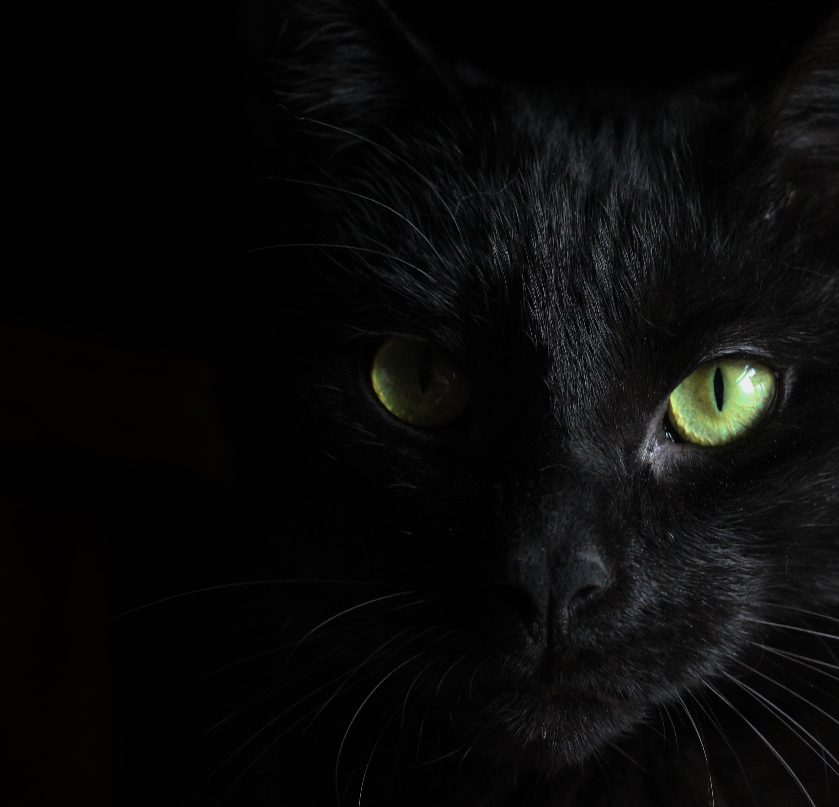
SEPTEMBER 18, 2023
TEL AVIV,
ISRAEL
THE DOG’S GARDEN STADIUM
“FEAR OF THE BARK”

